Slide 1
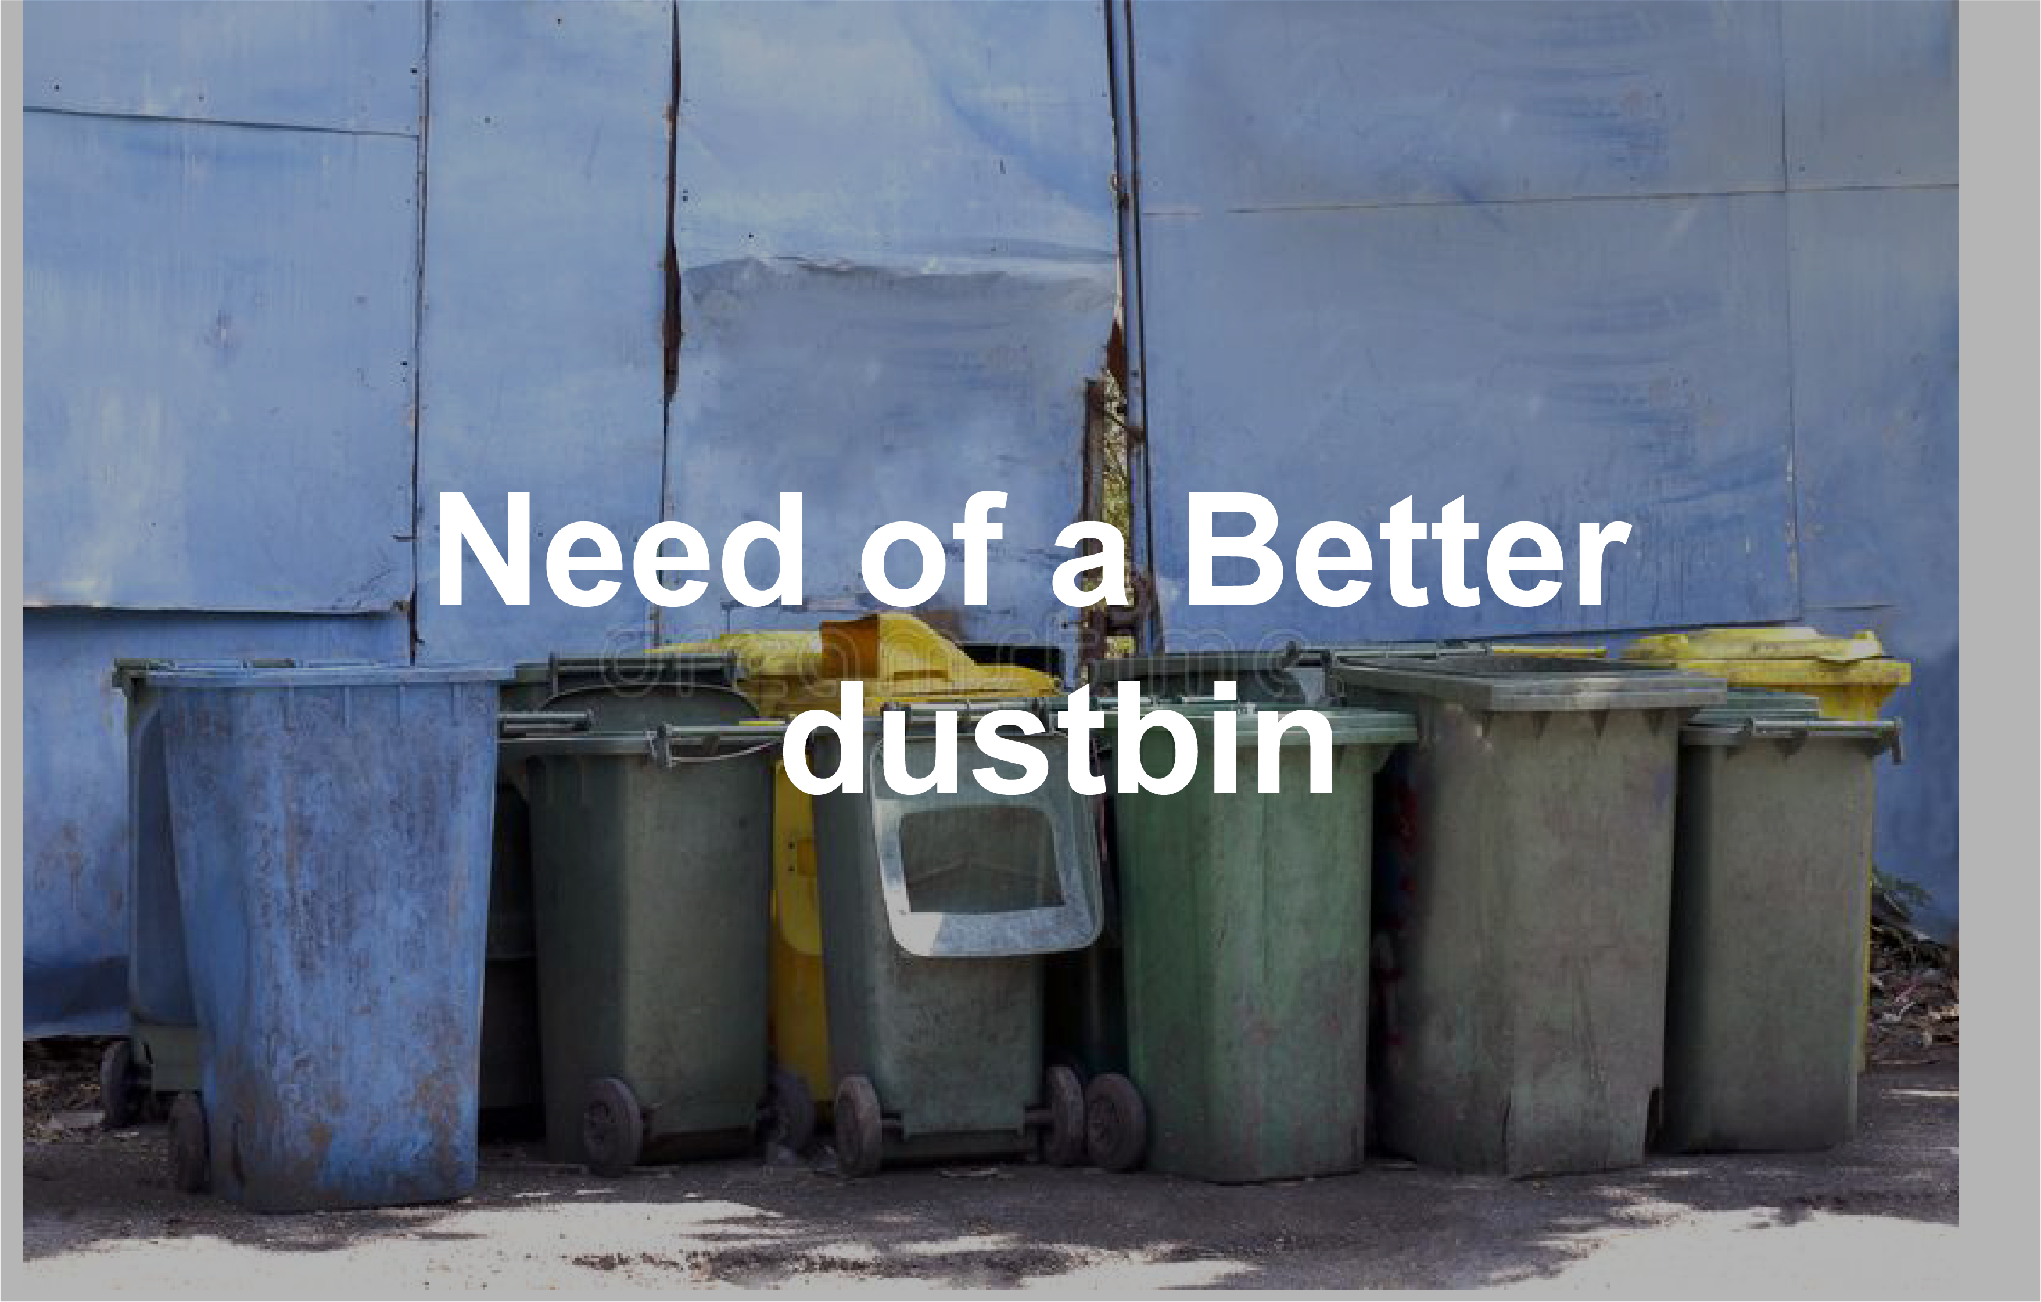

Slide 2
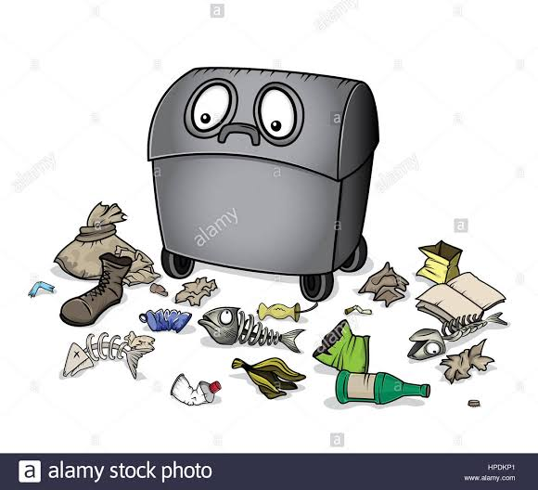
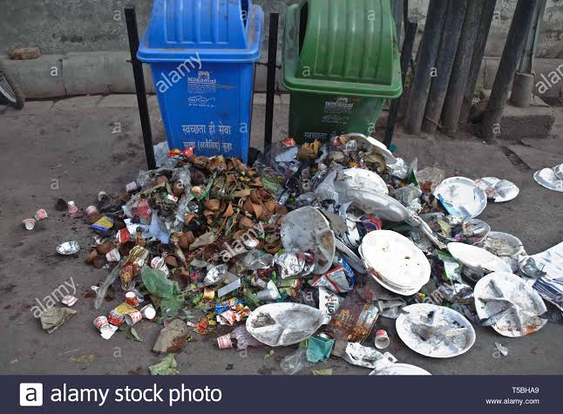
Public Dustbin

Slide 3
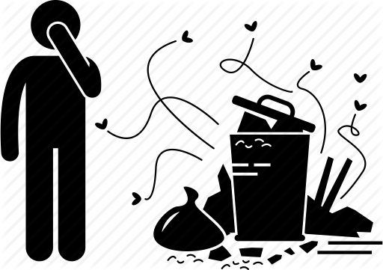
Reason

Slide 4
Solution
PROBLEMS | SOLUTIONS
They stink | Should have lid to prevent the smell from coming out
No one wants to open a dirty lid | Should have Automatic lid.
Discourages users to throw waste as no one wants to come near them. | Should open if a user is standing or passes through front of dustbin.

Slide 5
Smart Dustbin

Slide 6
SMART Features
FEATURES
Remains open until user is finished throwing waste.
Detects from even half a meter away.
Can even see in dark.
Lifetime of 3 month with one battery*.
Can also use Power Bank instead of battery.

Slide 7
FUTURE MODIFICATIONS
In future, we are going to make our dustbin even more smarter , which will make our dustbin more user friendly and will need lesser human efforts. We will modify Smart dustbin by adding sensors by which you just throw your waste towards dustbin and it detects the waste and open automatically . So that you can throw your waste from anywhere else. We will add voice control to our dustbin, so that we don’t need to go to dustbin, it will come to us by just your command.

